Slide 1

Introduction to Statistics and Data Analysis: Measure of location, variability and Graphical representation

Slide 2
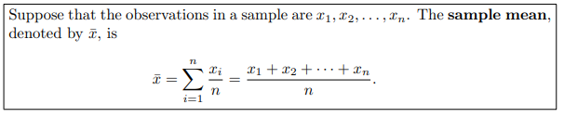
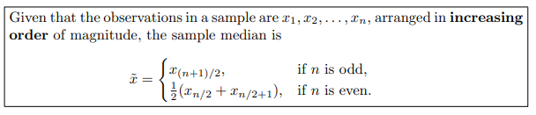
Measures of Location: The Sample Mean and Median
Measures of location are designed to provide the analyst with some quantitative values of where the center, or some other location, of data is located.
Definition 1.1:
Definition 1.2:

Slide 3
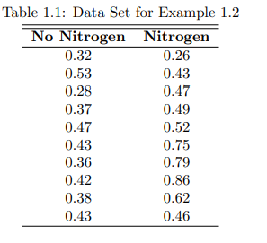

Example
Two samples of 10 northern red oak seedlings were planted in a greenhouse, one containing seedlings treated with nitrogen and the other containing seedlings with no nitrogen. All other environmental conditions were held constant.

Slide 4
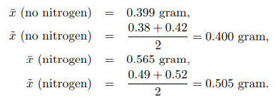
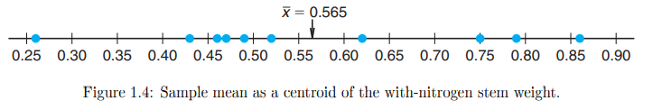
The two measures of central tendency for the individual samples are
Clearly there is a difference in concept between the mean and median. It may be of interest to the reader with an engineering background that the sample mean is the centroid of the data in a sample

Slide 5
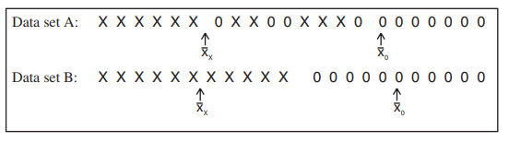
Measures of Variability
Sample variability plays an important role in data analysis. Process and product variability is a fact of life in engineering and scientific systems: The control or reduction of process variability is often a source of major difficulty

Slide 6
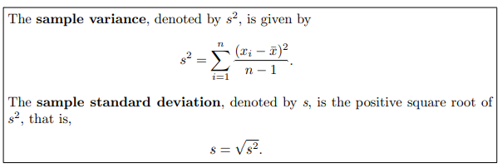
Sample Range and Sample Standard Deviation
Just as there are many measures of central tendency or location, there are many measures of spread or variability. Perhaps the simplest one is the sample range Xmax − Xmin. The range can be very useful on statistical quality control. The sample measure of spread that is used most often is the sample standard deviation. We again let x1, x2,...,xn denote sample values.
Definition 1.3:
The quantity n − 1 is often called the degrees of freedom associated with the variance estimate.

Slide 7
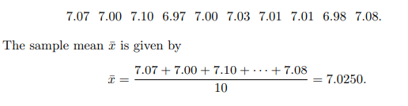
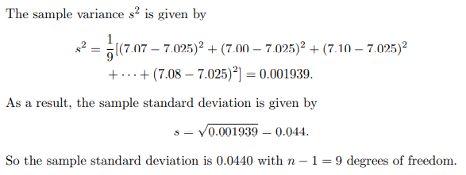
Example
A sample of size 10 is taken, with results given by

Slide 8
Units for Standard Deviation and Variance:
The sample variance possesses units that are the square of the units in the observed data whereas the sample standard deviation is found in linear units.

Slide 9
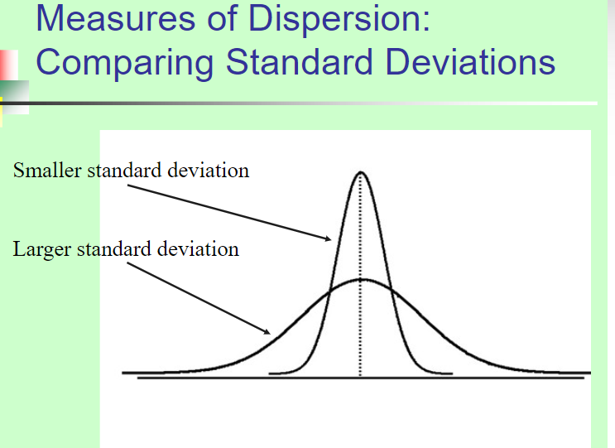

Slide 10
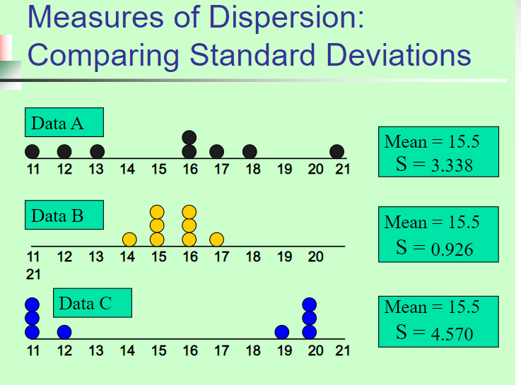

Slide 11
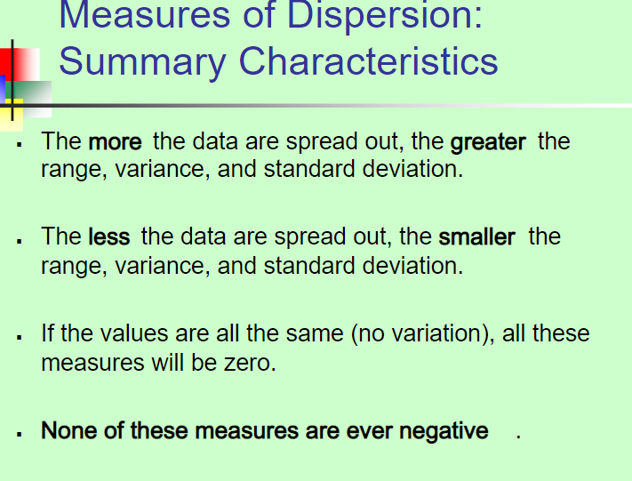

Slide 12
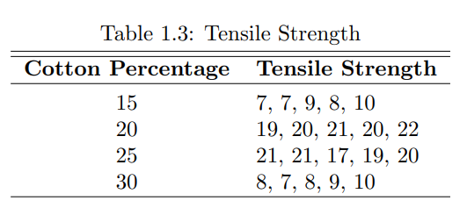
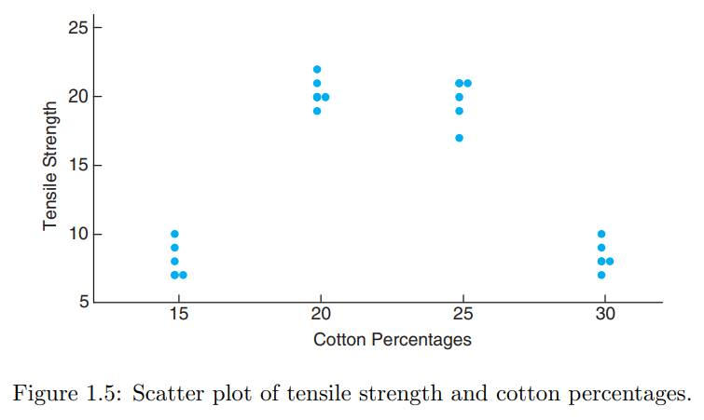
Graphical representation
Consider, for example, a textile manufacturer who designs an experiment where cloth specimen that contain various percentages of cotton are produced.
Scatter Plot:
Five cloth specimens are manufactured for each of the four cotton percentages.

Slide 13
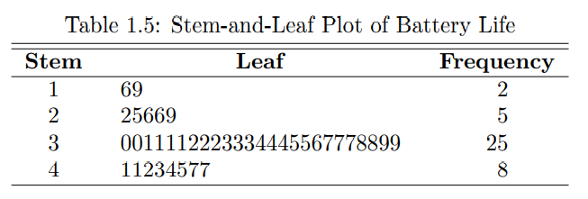
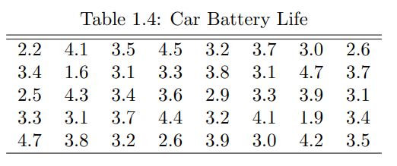
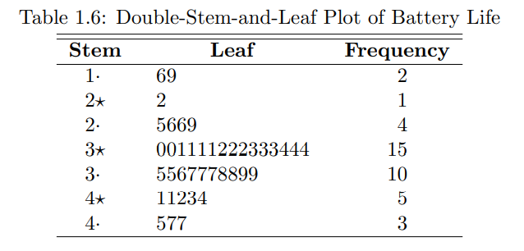
Statistical data, generated in large masses, can be very useful for studying the behavior of the distribution if presented in a combined tabular and graphic display called a stem-and-leaf plot.
Stem-and-Leaf Plot
To illustrate the construction of a stem-and-leaf plot, consider the data of Table 1.4, which specifies the “life” of 40 similar car batteries recorded to the nearest tenth of a year. The batteries are guaranteed to last 3 years.

Slide 14
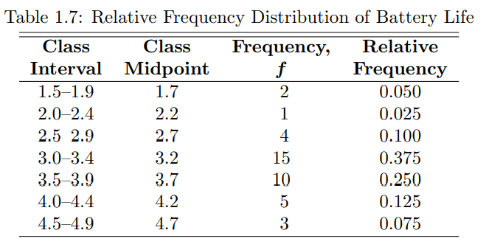
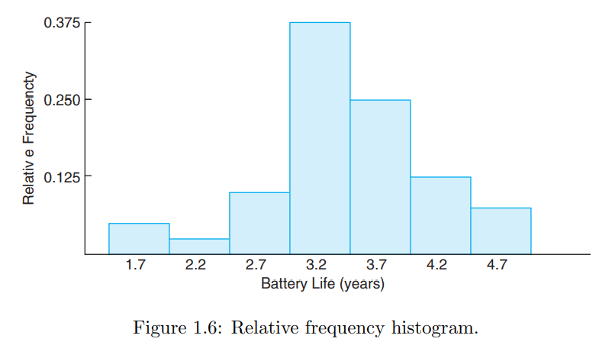
Histogram
The information provided by a relative frequency distribution in tabular form is easier to grasp if presented graphically. U
Using the midpoint of each interval and the corresponding relative frequency, we construct a relative frequency histogram

Slide 15
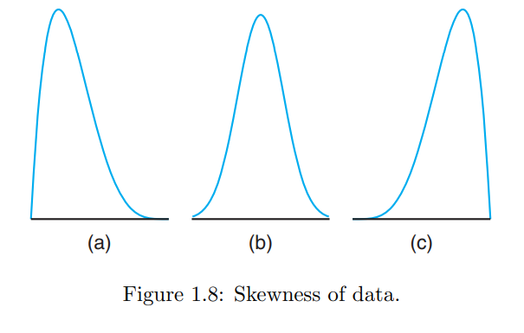
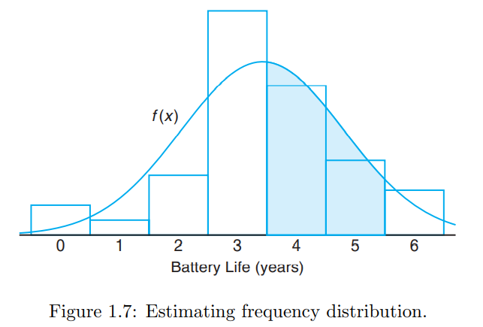
Many continuous frequency distributions can be represented graphically by the characteristic bell-shaped curve. Graphical tools such as what we see in Figures aid in the characterization of the nature of the population. In Chapters 5 and 6 we will discuss a property of the population called its distribution.
A distribution is said to be symmetric if it can be folded along a vertical axis so that the two sides coincide.
A distribution that lacks symmetry with respect to a vertical axis is said to be skewed.

Slide 16
Box-and-Whisker Plot or Box Plot:
Another display that is helpful for reflecting properties of a sample is the box and-whisker plot. This plot encloses the interquartile range of the data in a box that has the median displayed within. The interquartile range has as its extremes the 75th percentile (upper quartile) and the 25th percentile (lower quartile). In addition to the box, “whiskers” extend, showing extreme observations in the sample. For reasonably large samples, the display shows center of location, variability, and the degree of asymmetry.
In addition, a variation called a box plot can provide the viewer with information regarding which observations may be outliers. Outliers are observations that are considered to be unusually far from the bulk of the data. There are many statistical tests that are designed to detect outliers. Technically, one may view an outlier as being an observation that represents a “rare event” (there is a small probability of obtaining a value that far from the bulk of the data).

Slide 17
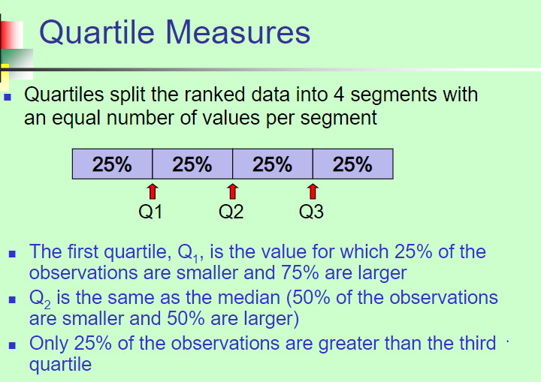

Slide 18
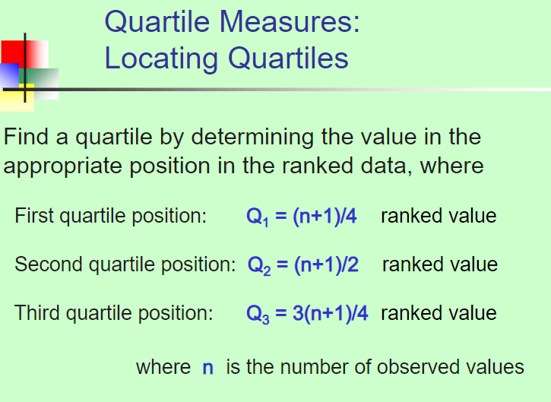

Slide 19
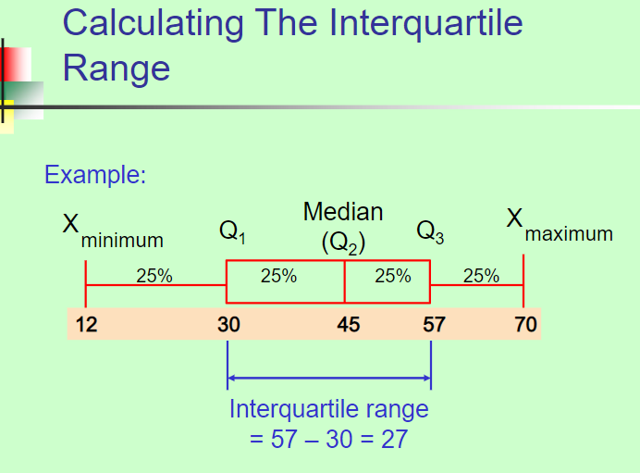

Slide 20
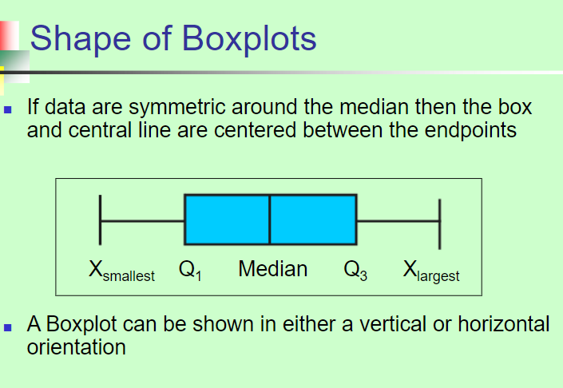

Slide 21
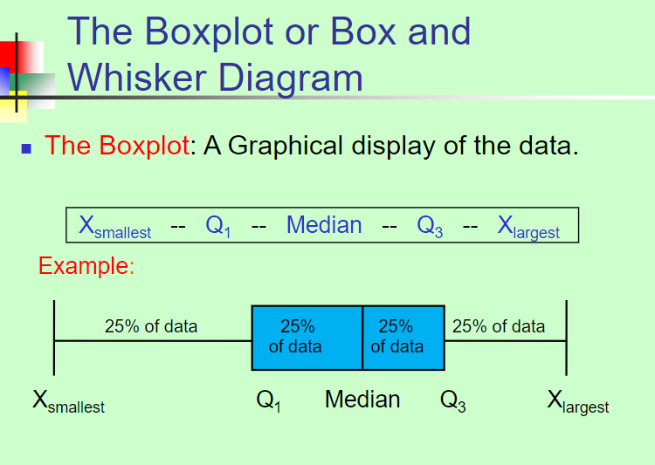

Slide 22
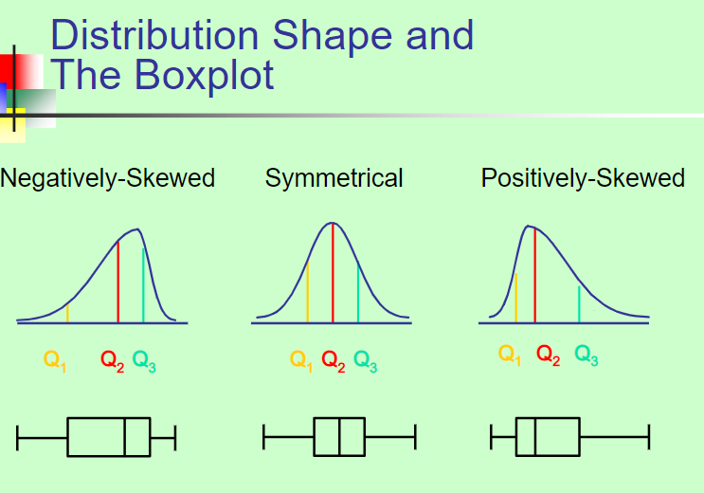

Slide 23
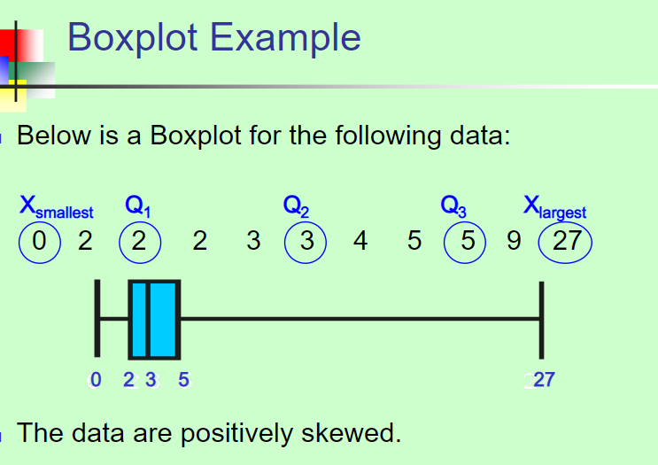

Slide 24
EXERCISE QUESTIONS
Page 13
Questions # 1.1, 1.2, 1.3, 1.4, 1.5, 1.6
Page 17
Questions # 1.7, 1.8, 1.9, 1.10

